Slide 1


Slide 2
Discovering Reactive extensions
- through the power of music (not clickbait) -

Slide 3

Reactive extensions
Library for working with asynchronous streams
Implemented in multiple languages (Java, JavaScript, C#, Swift)
How does it work?

Slide 4

Observer pattern
I forgot what that is…

Slide 5


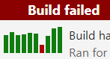
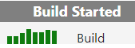

Observer pattern
Paul: Ponder life decisions
Paul
Notify
Subscribe
Notify
Subscribe
Madalin
Madalin: Give up on life

Slide 6
How do I use it?

Slide 7

Observables / Observers
What are those?

Slide 8




Observables
Observers
We look so cool like this
♪ tut tuuut ♪
We look so cool like this
And a 1, 2
1, 2, 3…
GO
♪ tuuut tut ♪
♪ dum ♪
♪ dum ♪
♪ dum ♪

Slide 9
Can you do both at the same time tho?

Slide 10

Subjects
Aaaaand… go
♪ boom ♪
I should find some friends
♪ boom ♪
♪ boom ♪

Slide 11

Cool! How do I make some?

Slide 12

OPERATORS!
Geez… you don’t have to scream

Slide 13

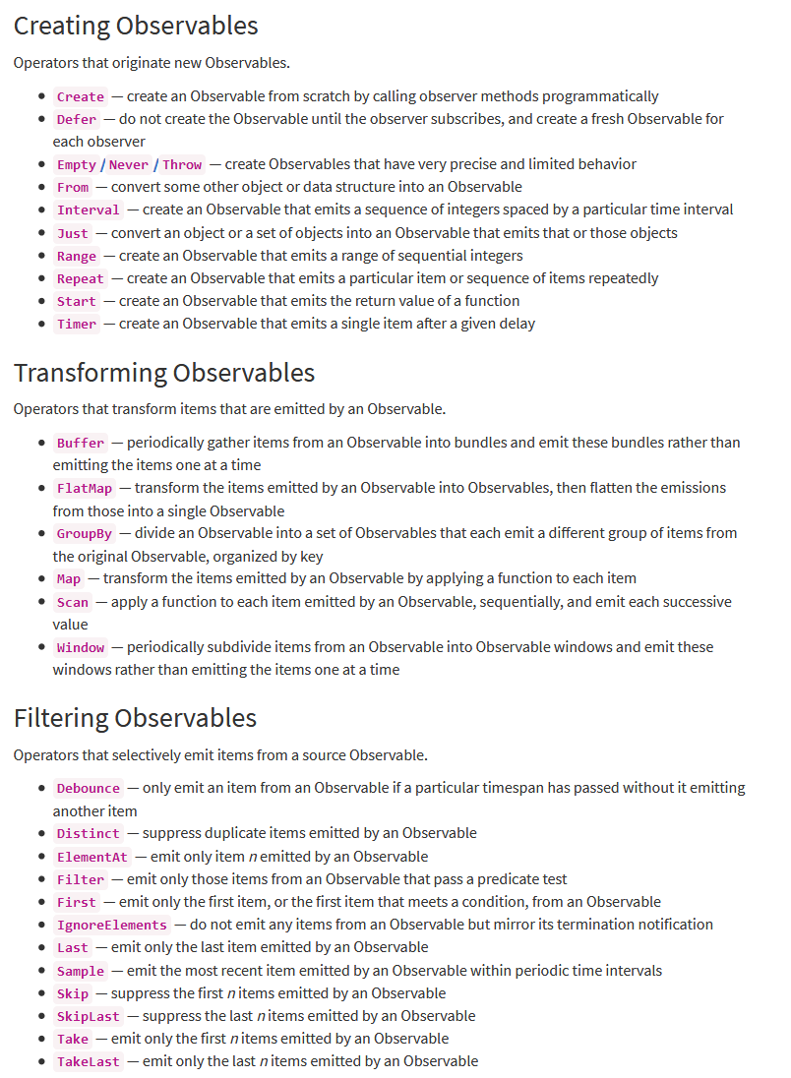
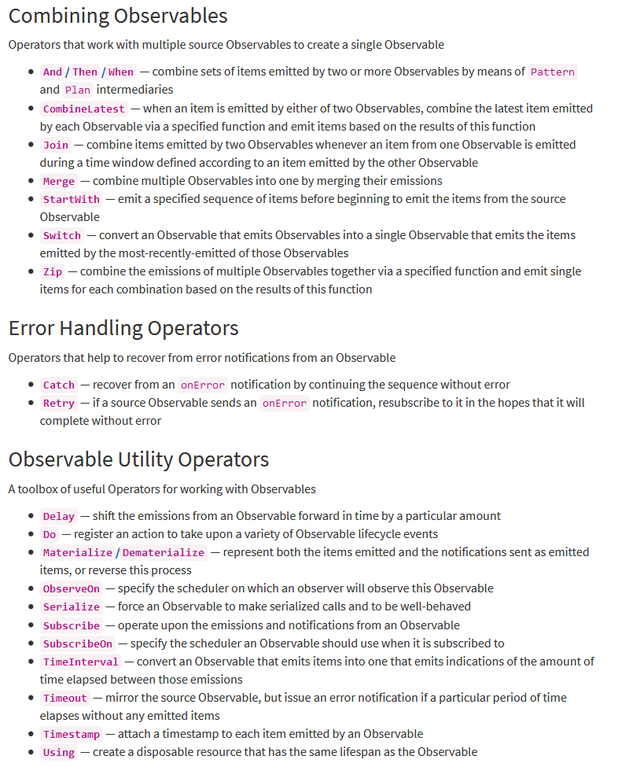
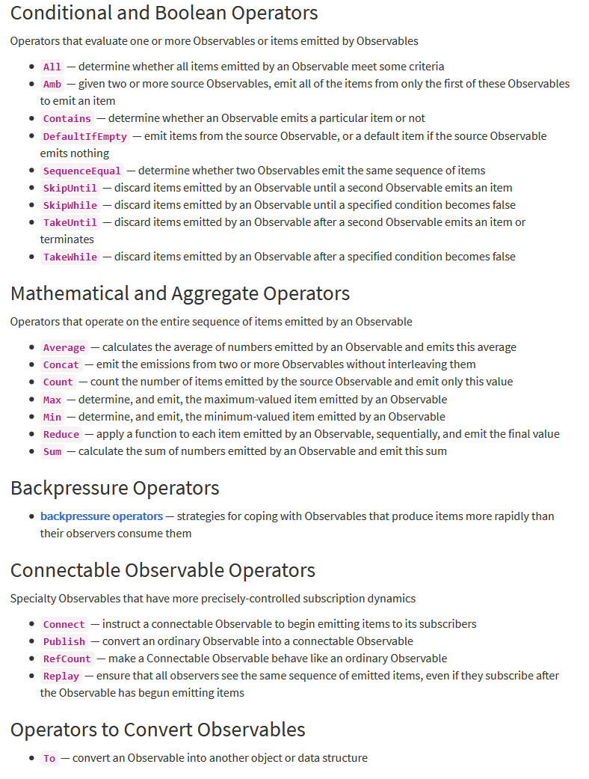
Operators
Umm… can you show me an example?

Slide 14
Usual flow
Define your problem
For this example, we want to bundle up events we receive into groups of three.

Slide 15
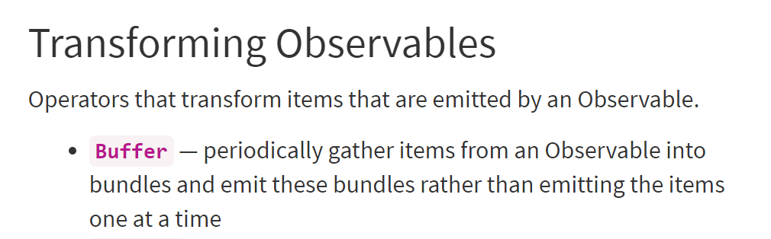
Usual flow
Search for an operator that sounds like what you’re looking for

Slide 16
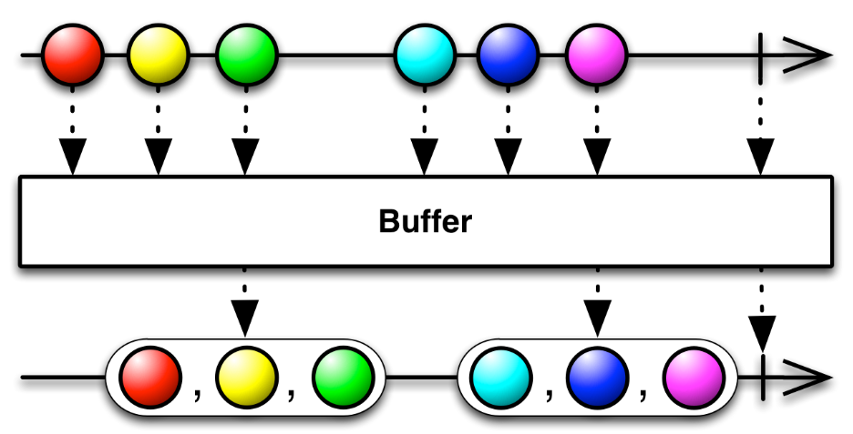
Usual flow
Read the marble diagram and see if it is what you really want

Slide 17
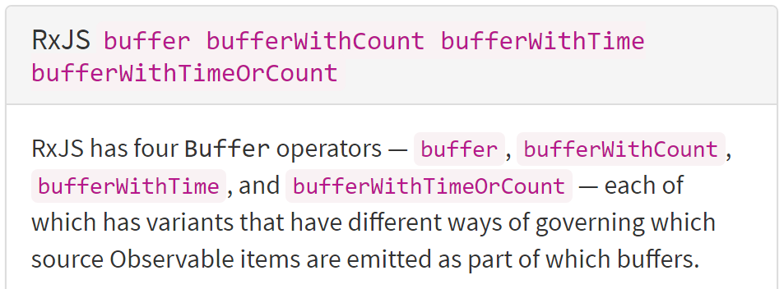
Usual flow
Look for the Javascript specific details

Slide 18
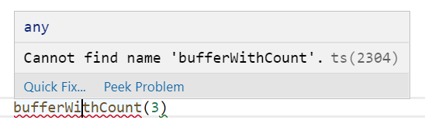
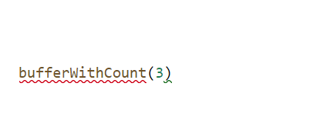
Usual flow
Try to use the version you need in your code – Fail at it
Try to use the version you need in your code

Slide 19

Usual flow
Google some more until you find the learnrxjs website

Slide 20
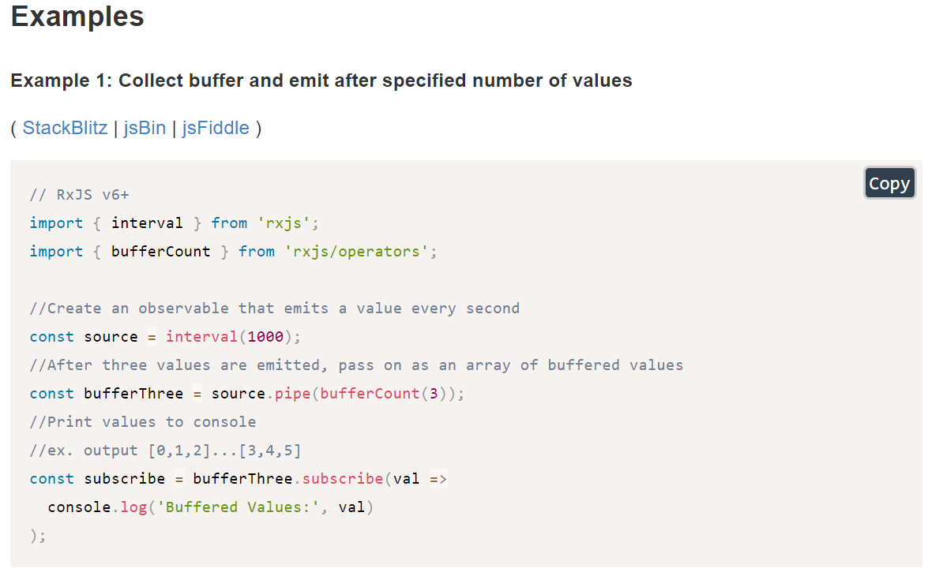
Usual flow
Understand how to use it from the examples

Slide 21
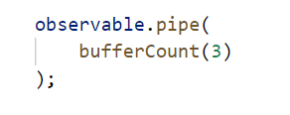
Usual flow
Implement your code

Slide 22

DEMO TIME!
I got my glasses on.
LET’S CODE!
Notes:
https://github.com/paul-antal/ReactiveMusic.git

Slide 23
Questions?

